Slide 1
Machine Learning
Unit-3

Slide 2
Linear Models

Slide 3
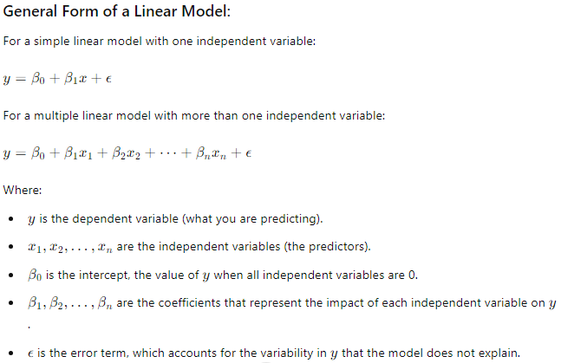
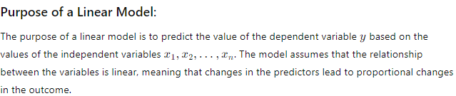

Slide 4
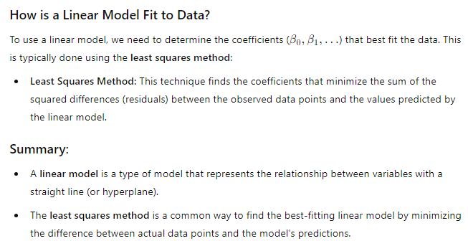

Slide 5
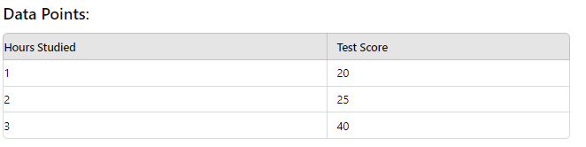
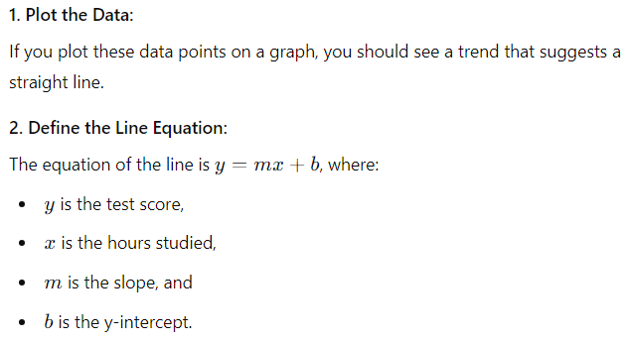
Least Squares Method:-

Slide 6
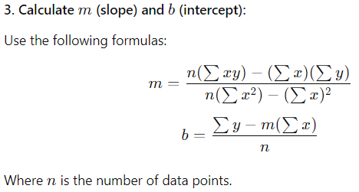
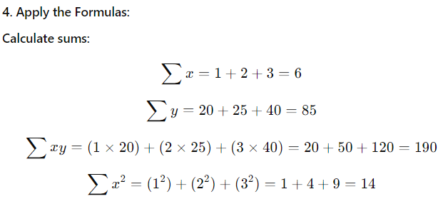
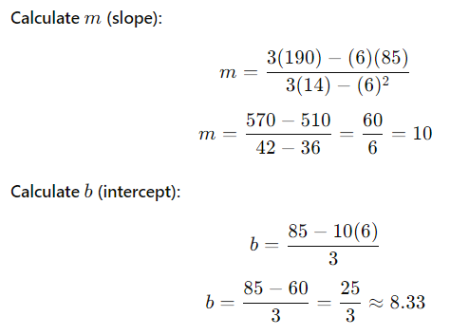

Slide 7
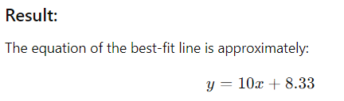
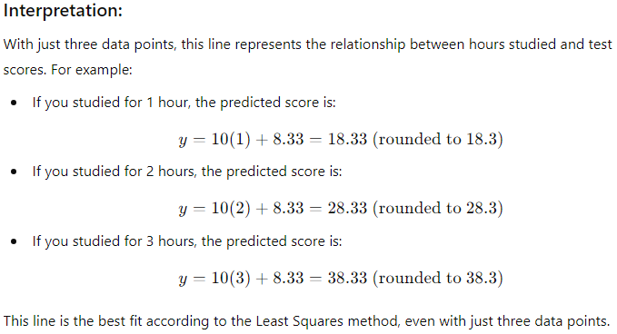

Slide 8
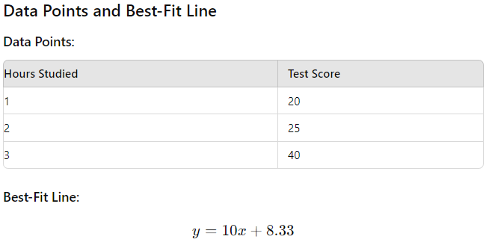
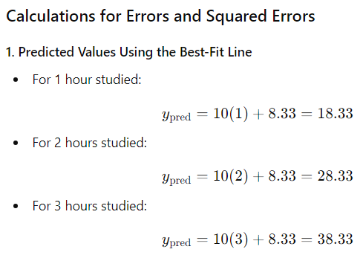
To show how the line y=10x+8.33y = 10x + 8.33y=10x+8.33 minimizes the error, we will calculate the errors for each data point and then find the squared errors. We’ll compare these with errors from a different line to demonstrate that the Least Squares line minimizes the total squared error.

Slide 9
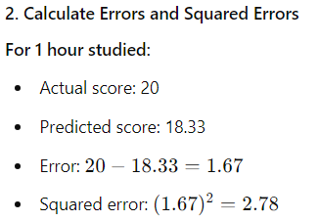
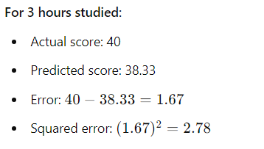
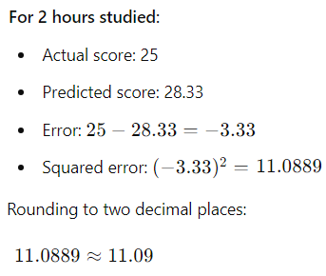
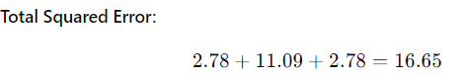

Slide 10
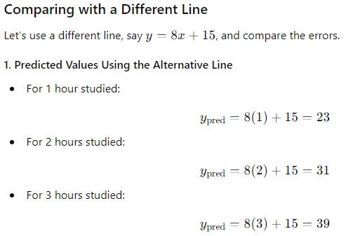

Slide 11
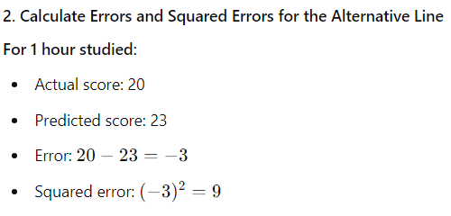
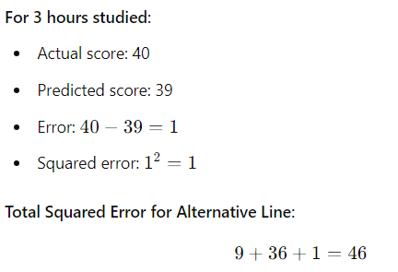
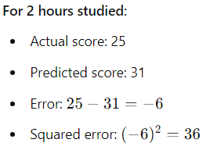
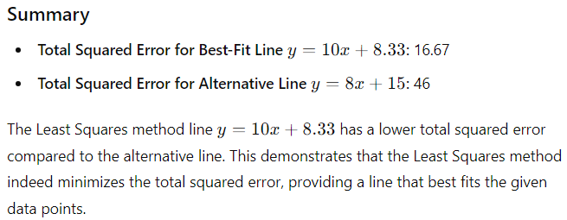

Slide 12
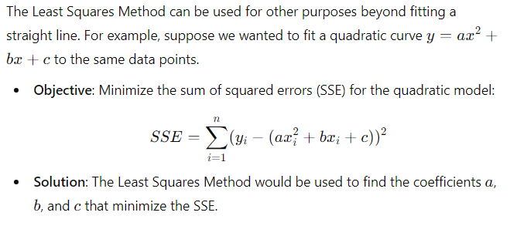

Slide 13
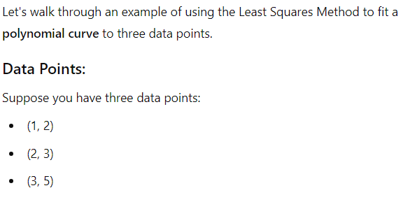

Slide 14
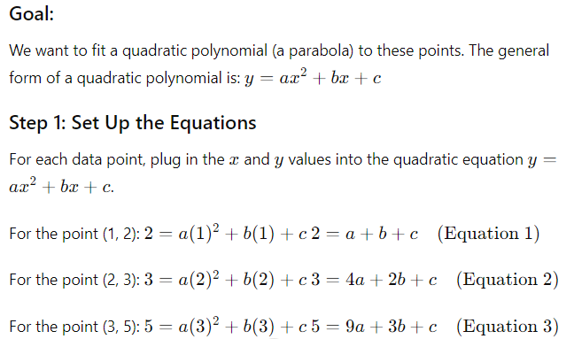
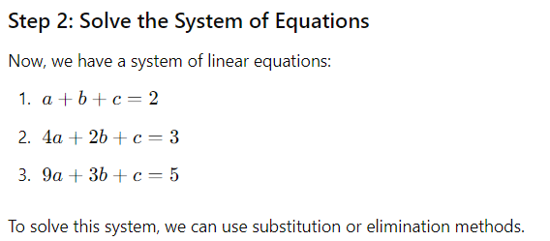

Slide 15
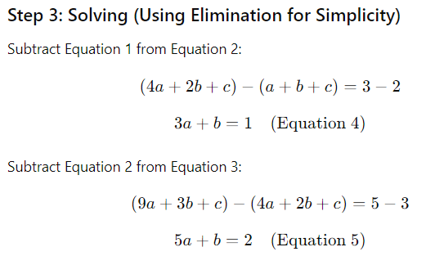
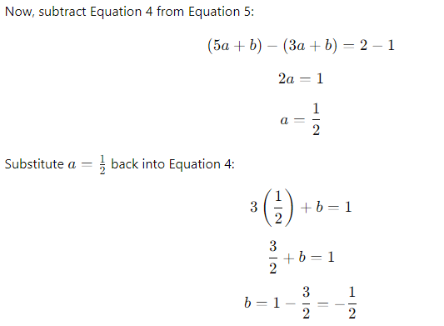
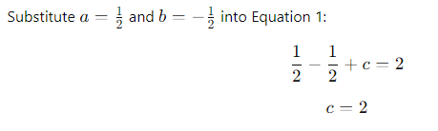

Slide 16
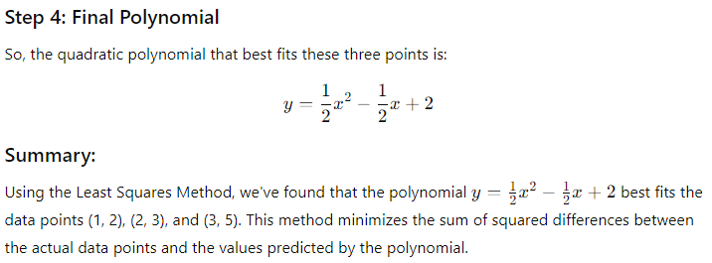

Slide 17
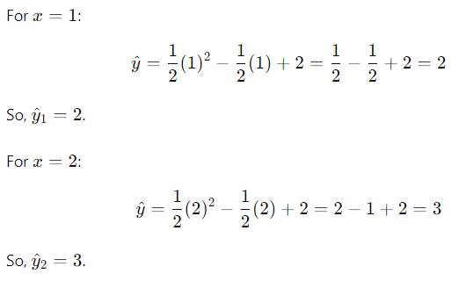
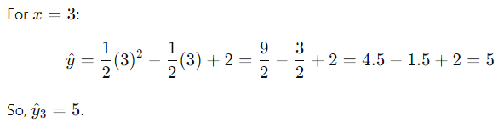

Slide 18
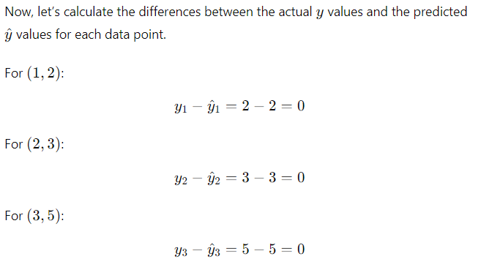
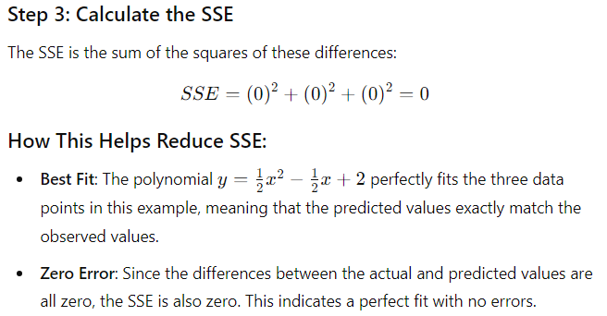
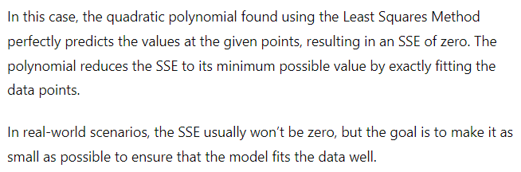

Slide 19
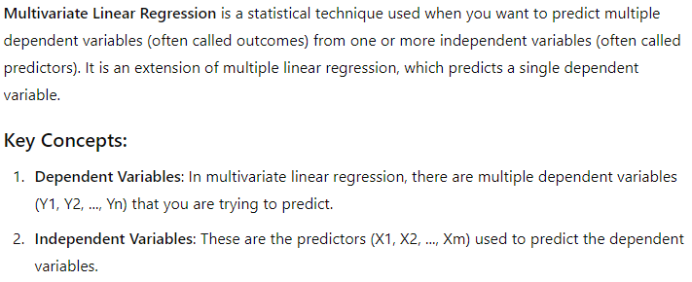
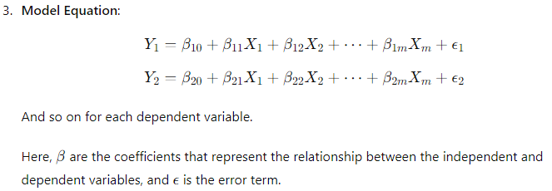
Multivariate Linear Regression:-

Slide 20
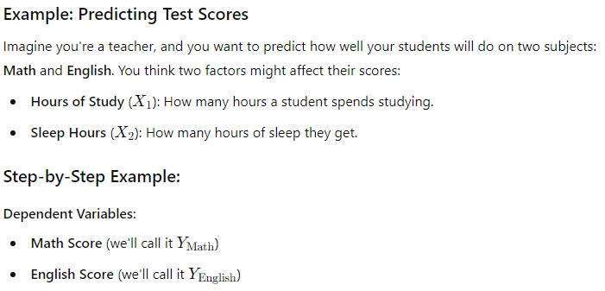
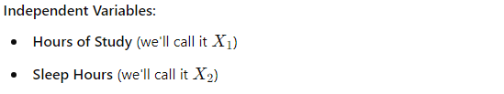

Slide 21
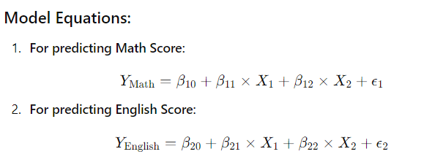
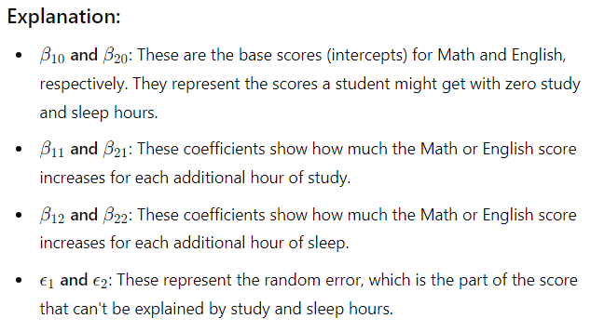

Slide 22
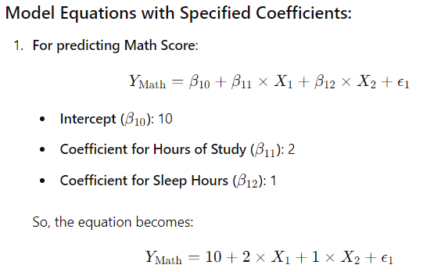
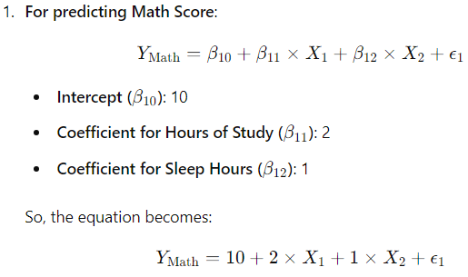
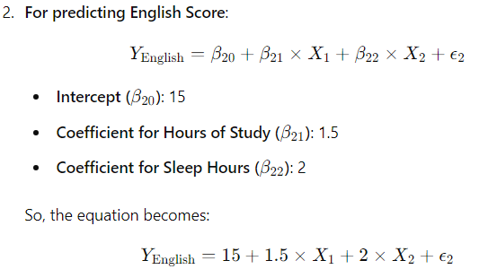

Slide 23
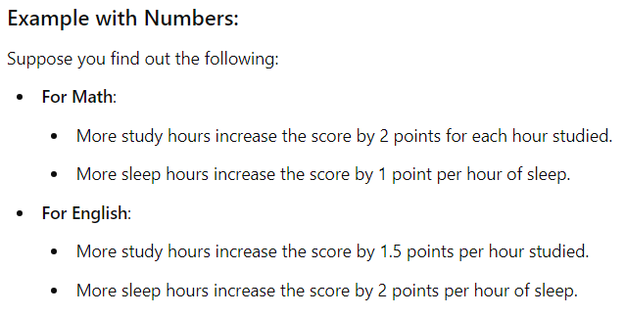
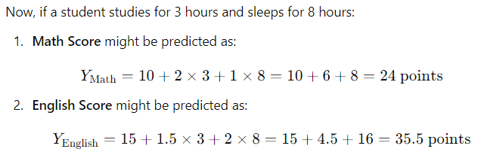

Slide 24
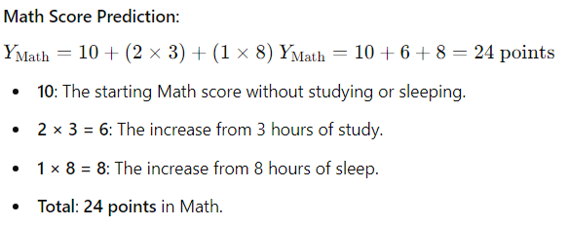
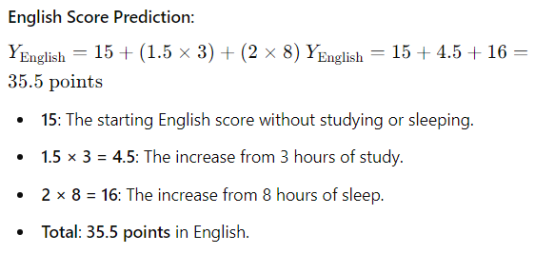

Slide 25
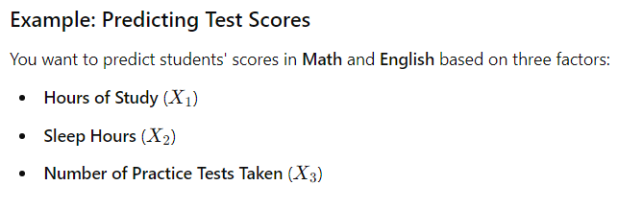
Let’s see another example.

Slide 26
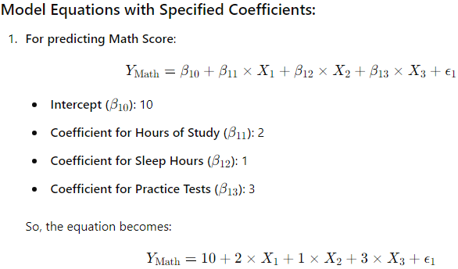
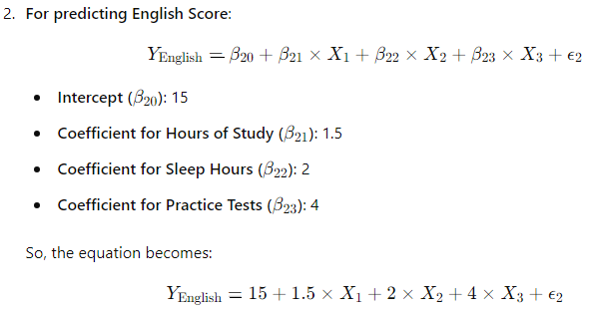

Slide 27



Slide 28



Slide 29



Slide 30

Comparison between Multiple Linear Regression and Multivariate Linear Regression:-

Slide 31

Comparison between Multiple Linear Regression and Multivariate Linear Regression:-

Slide 32

Regularized regression:-

Slide 33


Slide 34



Slide 35


Slide 36


Slide 37



Slide 38

Workflow of LASSO:-

Slide 39

Penalty Term: The LASSO method adds a penalty to the usual error calculation (SSE). This penalty is based on the size of the feature coefficients.

Slide 40


Applying to Each Feature: The penalty term affects each feature's coefficient individually. The larger the absolute value of a coefficient, the larger the penalty, which increases the overall cost.

Slide 41


Feature Relevance: The model tries to balance lowering the error and the penalty. If a feature's contribution isn't significant enough to justify its penalty, the model reduces its coefficient to zero, essentially removing it.

Slide 42

Workflow of Ridge:-

Slide 43


Adding the Penalty Term: The Ridge cost function adds a penalty term (which is proportional to the sum of the squares of the coefficients) to the SSE. This combined cost function is what the model tries to minimize.

Slide 44


Implementation Across Features: The penalty term affects each feature's coefficient individually. The larger the squared value of a coefficient, the larger the penalty, which increases the overall cost.
To address this,
Feature Shrinkage: Unlike LASSO, Ridge regression doesn’t set coefficients to zero. It only shrinks them, which means all features remain in the model but with reduced influence.

Slide 45


Slide 46

Elastic Net Regression

Slide 47


Slide 48


Slide 49
Least squares regression:-
The least squares method is a general technique used in various types of regression models, including linear regression and polynomial regression. When you apply the least squares method specifically in the context of these regression models, it's often referred to as least squares regression.

Slide 50

Using least square regression in classification:-

Slide 51


Slide 52



Slide 53



Slide 54

Perceptron

Slide 55

In this given example, suppose, lets consider, artists are good, weather is not good, friends are good and foods are all served. Now, with the help of perceptron, we will decide whether we should go to concert or not.

Slide 56


Suppose, threshold is set as 2.1:-

Slide 57

Pictorial Representation of a perceptron:-

Slide 58



Pictorial Representation of a perceptron (explaination):-

Slide 59



Slide 60





Slide 61




Slide 62


Question arises; in perceptron, from where we got values of weight here?

Slide 63



Slide 64




Slide 65


Slide 66



Slide 67


Another question arises; in perceptron, how threeshold are set?

Slide 68


Slide 69



Slide 70

Support Vector Machines

Slide 71

In SVC:-

Slide 72

In SVR:-

Slide 73


Slide 74

Comparison between Support Vector Classification (SVC) and Support Vector Regression (SVR).

Slide 75



Slide 76
Soft Margin SVM
Imagine you're trying to draw a line on a piece of paper to separate two different types of candies, like chocolates and gummies. In a perfect world, you could draw a straight line that separates all the chocolates on one side and all the gummies on the other. But sometimes, it's not that easy—maybe some gummies look like chocolates, or some chocolates are mixed in with the gummies. That's when it gets tricky.
The Soft Margin is like saying, "It's okay if a few candies end up on the wrong side of the line." Instead of forcing a perfect line (which might be impossible), we allow a little bit of mix-up, but still try to keep most candies on the correct side.
In other words, a Soft Margin allows some mistakes to make sure we get the best possible line that works well overall, even if it’s not perfect. This helps the line work better when you try it on new candies you haven't seen before.

Slide 77

Both hard margin and soft margin are concepts used in Support Vector Machines (SVMs) for classification tasks.

Slide 78


In basic terms, the problem with using a hard margin in a Support Vector Machine (SVM) is that it can be too strict. Here’s why:

Slide 79

Now, lets go in details.
Before moving on to soft margin SVM, let's first understand hard margin SVM.

Slide 80





Lets understand each equation first:-
1.

Slide 81


2.

Slide 82




Understanding in details:-

Slide 83


Slide 84


3.

Slide 85


4.

Slide 86



Slide 87


Now, coming to soft margin SVM:-

Slide 88


Slide 89


Slide 90


Slide 91

Soft margin SVMs and slack variables are crucial for handling non-linearly separable data by allowing some misclassification to achieve a better overall model.

Slide 92



Slide 93





Slide 94





Slide 95

There are few challenges in C in soft margin svm equation:-

Slide 96

Difference between Hard Margin SVM and Soft Margin SVM:-

Slide 97

Linear Classifier:-

Slide 98


Slide 99

Obtaining probabilities from linear classifier:
Logistic regression:
By using statistical software, suppose, we got to know that the b0 = -5.75 and b1=2.75, find the probability.

Slide 100

Now, by using the formula, we got the probability.

Slide 101


Slide 102


Slide 103


Here, In(Odds) means Logit.

Slide 104

In logistic regression,

Slide 105

Note:- If the values of In(odd) and logit equation (b0+b1x) are not exactly same but are close, it's likely due to minor calculation errors, approximations or round off, and this is generally acceptable.
As long as the difference is small, it shouldn't affect the overall interpretation of the results significantly.

Slide 106


Slide 107


Slide 108


Slide 109



Slide 110

Difference between Sigmoid and Softmax:

Slide 111

Kernel methods for non linearity:-

Slide 112


